Slide 1

Service Fabric Internals, p1

Slide 2

Service Fabric

Slide 3
Cloud Considerations
Don’t own the hardware
Failures are part of the game
Scale is unpredictable
Managing services is harder than building them
Advanced telemetry for visibility required
No downtime for upgrades
Do you control your costs? How about density?
Dedicate attention for security

Slide 4
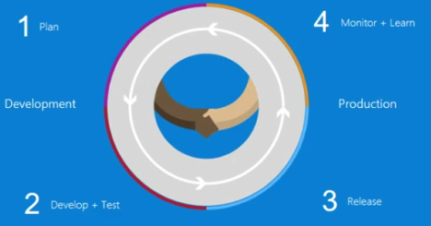
Why Microservices
Evolve continuously
Faster delivery
Build and operate at scale

Slide 5
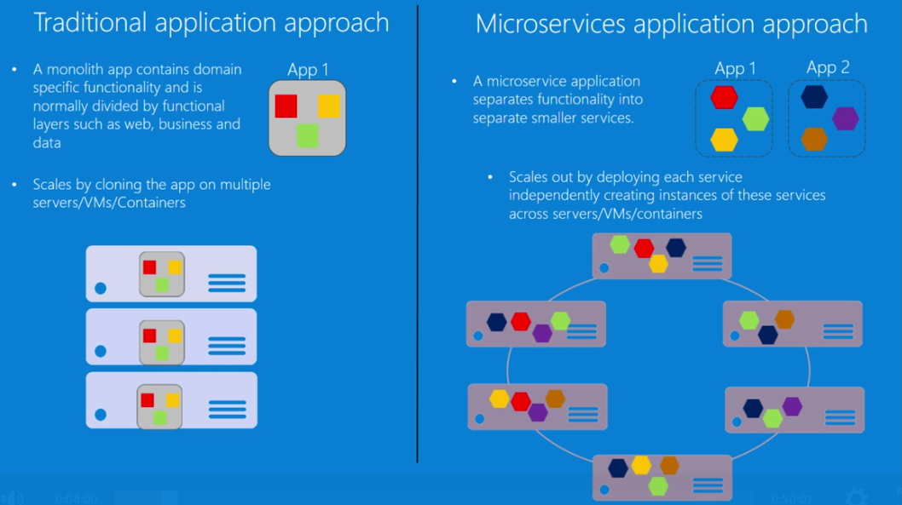

Slide 6
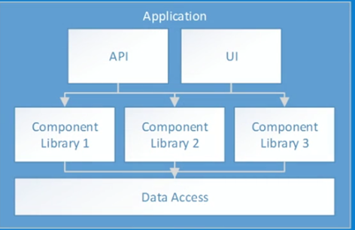
Application Design - Traditional
Pros
Compile-time contract validation
Local operations
Easier to understand
Cons
Expensive to scale application
Hard to scale data access
Upgrades are difficult

Slide 7
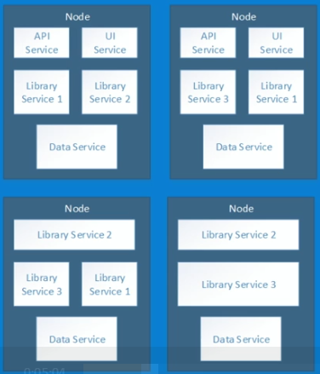
Application Design – Service Oriented
Pros
Cheaper to scale application
Easier to scale data access
Upgrade continuously
Cons
Runtime contract validation
Network operations
Harder to understand

Slide 8
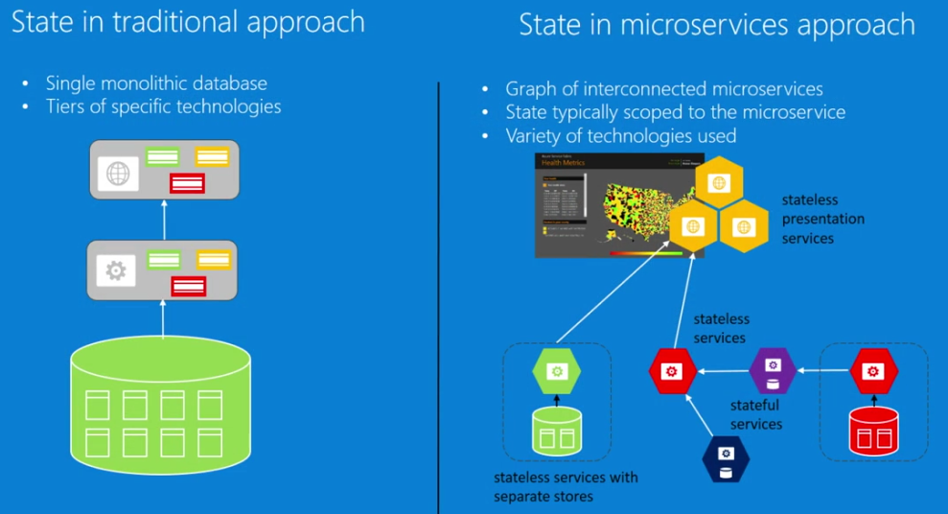
State

Slide 9
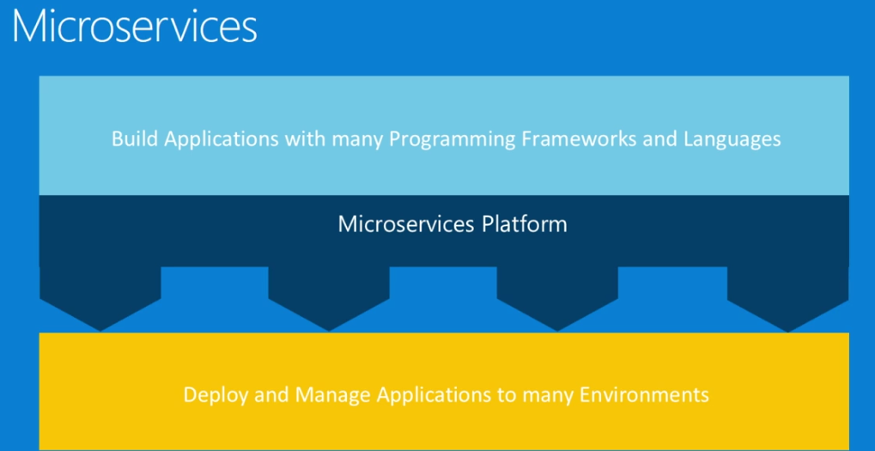

Slide 10
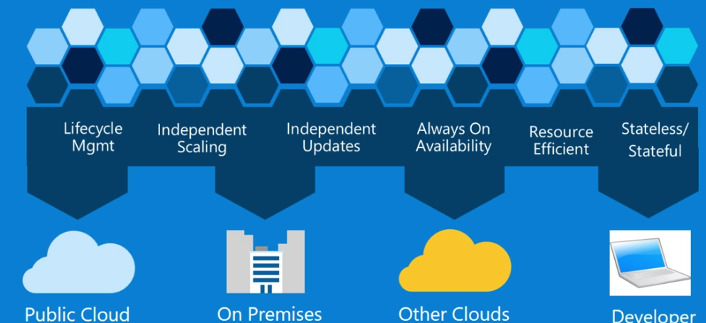
Azure Service Fabric

Slide 11
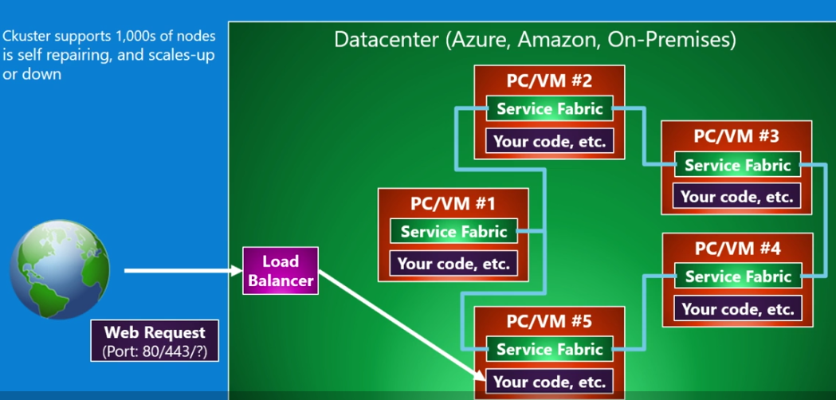
Service Fabric Cluster

Slide 12
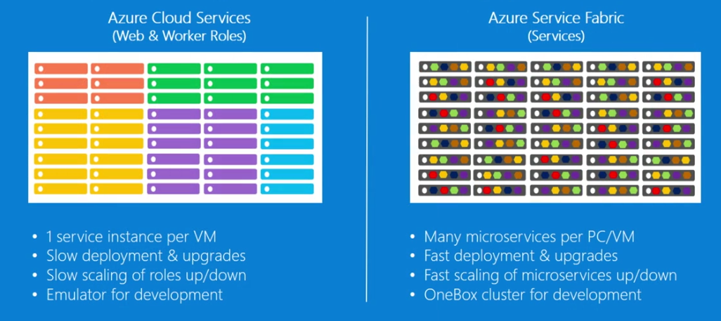
Cloud Service vs Service Fabric

Slide 13
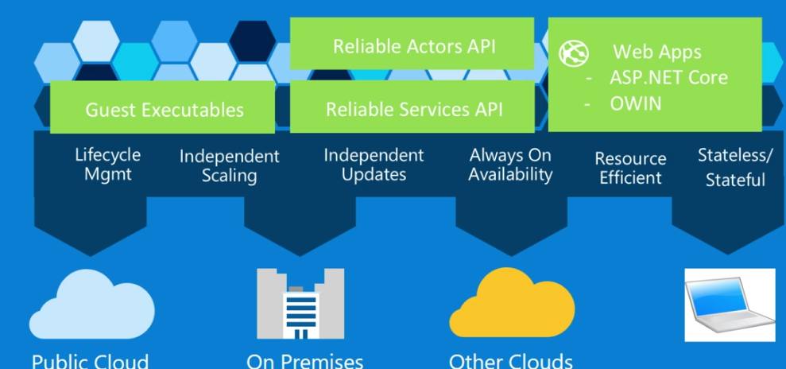
Service Fabric Programming Models

Slide 14
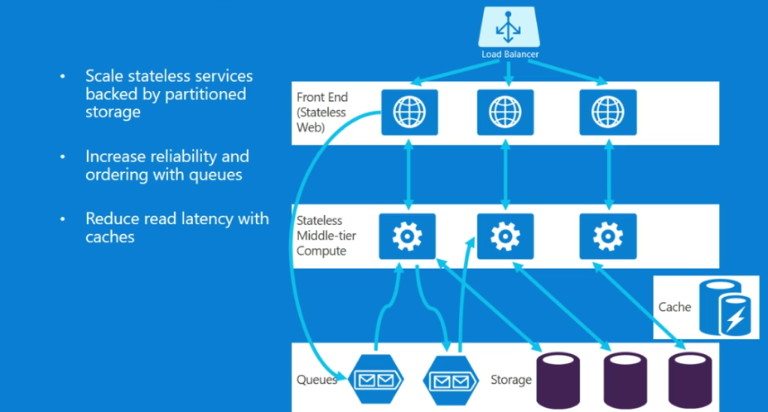
Stateless Service Pattern

Slide 15
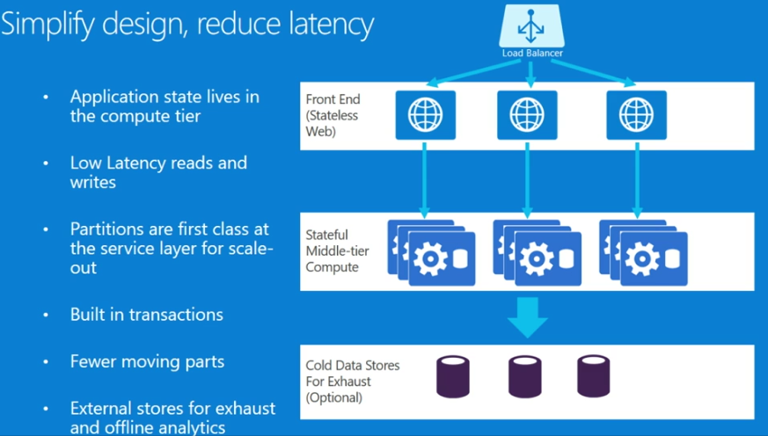
Stateful Service Pattern

Slide 16
Types of Microservices
Stateless Microservice
State is stored externally
We can have N instances
Web frontends, protocol gateways, Azure Cloud Serivces
Stateful Microservice
Maintain hard, authoritative state
N consistent copies achieved through replication and local persistence
Database, documents, workflows, user profile, shopping cart

Slide 17
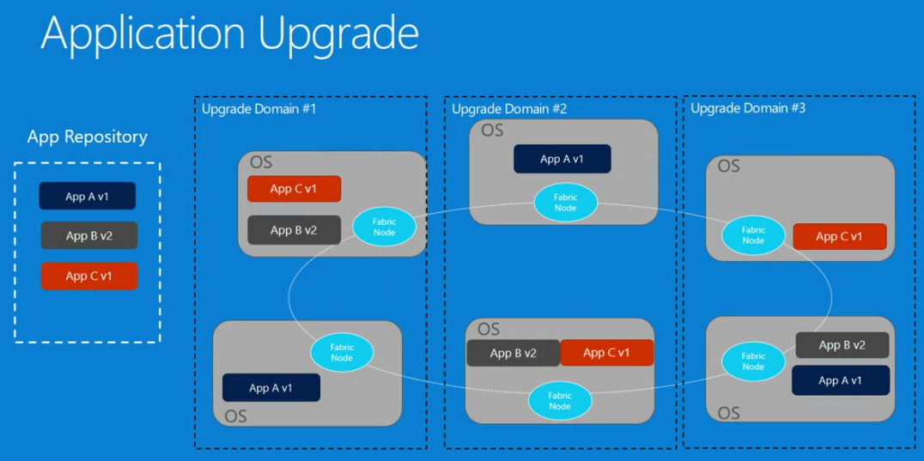

Slide 18
Demo Stateless Service
Notes:
Dashboard
Deactivate node
Show diagostics
Enable node

Slide 19
Demo Stateful Service

Slide 20
Migrating a traditional application
Decide on the problems you are solving
Scale, agility, resilience
Decided on a well define area to re-architect
You can have mixture of traditional and microservice designs

Slide 21







Stages of migrating a traditional application
2) Traditional app hosted as guest executable or container in Service Fabric
3) Traditional app with new microservices
4) Breaking the Traditional app into microservice
5) Transformed into microservices

Slide 22


Migrating a traditional application
Traditional app
Hosted as guest executable or container in Service Fabric
With new microservices added alongisde
Breaking into microservices
Transformed into microservices
…You can stop at any stage

Slide 23







Common design pattern using gateways
Web Gateway
REST/Websockets
Load
Balancer
API Management
IoT Hub
Event Hub

Slide 24


Using a gateway to integrate a traditional app with Service Fabric
Gateway
Client
Client

Slide 25
Problem
Cluster Management nightmares
I always worry about running out of capacity ?
I am not sure if all the VM resources are utilized ?
I am worried sick about my cluster being compromised.
I have no control on when a new Service fabric version is rolled out to my cluster.
I am not sure if what disasters my cluster can survive ?

Slide 26
Best Practice
Service Fabric Cluster Management nightmare mitigation
Let us divide the problem space into three buckets
Plan out your cluster capacity
Optimize and Secure your cluster
Manage your cluster version

Slide 27
Best Practice
Service Fabric Cluster planning
Capacity planning is not an easy exercise.
Capacity planning is not a one time exercise.
Do not assume that you can add capacity on demand instantly.
Do not assume that you can take downtime to change capacity later
Here are some of the questions you will need answer for, before you can truly plan out your cluster.

Slide 28





Service Fabric Cluster planning
Source Control
Build
What is this cluster to be used for ?
Is this to be used for Test ?
Is this a part of the CICD pipeline ?
Is this for Production use ?
Where do you want this cluster hosted ?
On Azure ?
On-Premise, in your data center ?
On some other cloud provide ?
Are there unique compliance and security requirements?
End-to-end RBAC and Auditing ? Certificates OK ? Active Directory OK ?
Compliance expectations from the infrastructure ?
Compliance goals on the application ?
PPL
Inner Dev Loop
Test
PROD
DEV
OPS
OPS

Slide 29
Service Fabric Cluster planning
What kinds of workloads are planned to be deployed to it ?
For each Application
Total State
# of instances
Replica set size
Port requirements per service
IOPS needed
External state vs State in the Service Fabric Clusters.
Growth rate
How many Node types (what kinds of apps are to be deployed)
Are their non-SF services to be run as well ?

Slide 30
Service Fabric Cluster planning
Once you know what each Application needs, focus on Characteristics of each nodetype.
CPU
RAM
Disk (total state of the replicas you want to host)
State durability (Gold vs Silver)
Reliability (applies only to primary node type).
Fault tolerance - # of FD and # of UD
Choosing the # of FDs
This determines the headroom needed in case of unplanned failures.
Choosing the # of UDs
This determines the headroom needed in case of planned failures.

Slide 31
Choosing the # of Fault Domains you need
Number of Fault Domains determines the headroom needed in case of unplanned failures.
Examples could be a PDU failing or TOR maintenance . Which will typically take out all machines in a Rack.
PDU Burn out
FD1
Replica
FD2
FD3
FD4
FD5
In terms of capacity – you need to leave enough headroom to accommodate failure of at least one FD
This will result in SF moving/creating new replicas on the available Machines in other FDs.

Slide 32
Choosing the # of Upgrade Domains you need
Number of Upgrade Domains determines the headroom needed in case of planned failures/downtimes.
Examples could be a service fabric upgrade going on, and a UD is down. You have to have room to place additional replicas if need be.
SF upgrade
UD1
UD2
UD3
UD4
UD5
UD6
UD7
UD8
UD9
UD10
Replica
FD1
FD2
FD3
FD4
FD5

Slide 33
Best practice – capacity headroom
You should plan your capacity in such a way that, your service can survive at least
A loss of one FD
A UD being down because of an upgrade going on
A random node/VM failing additionally.
UD1
UD2
UD3
UD4
UD5
UD6
UD7
UD8
UD9
UD10
FD1
FD2
FD3
FD4
FD5

Slide 34
Best practices – Cluster Set up
Use ARM template to customize your cluster
Spread VMs across multiple storage account
Fan out the IO
Protection against widespread outage
Use ARM template to drive changes to your Resource Group
Easy configuration management
Auditing
Avoid using implicit commands to tweak your resources.
Be very pedantic on the configurations your deploy to your production environment

Slide 35
Best practices – Cluster Set up
Use a separate node type to host system services for large clusters – for large cluster.
Legend
7- SF nodes
10 - NT1 Nodes
20 -NT2 Nodes
UD1
UD2
UD3
UD4
UD5
UD6
UD7
UD8
UD9
UD10
FD1
FD2
FD3
FD4
FD5

Slide 36
Best practices – Cluster Security
Always use a secure cluster to deploy anything you care about
Additionally consider the following
Create DMZs using NSGs
Use Jump boxes to manage your cluster

Slide 37
Best practices – Cluster Security
Service Fabric Cluster
Service Fabric Cluster
Security
VNET
Key Vault
LB#3
NSG#1
NSG#2
LB#3
LB#1
NSG#2
LB#1
LB#2
NSG#1
LB#2
AAD
NSG#2
NSG#2
VMSS#1
VMSS#1
VMSS#1
VMSS#1
VMSS#1
VMSS#1
Azure Storage
VM
VM
VM
VM
VM
VM
VM
VM
VM
VM
VM
VM
VM
VM
VM
VM
VM
For Diagnostics
VM
Jump box
For SF logs
For VHDs
For VHDs
For VHDs

Slide 38
NSG ports that needs to be opened
ClientConnectionEndpoint (TCP): 19000
HttpGatewayEndpoint (HTTP/TCP): 19080
SMB – 445 and 135
ClusterConnectionEndpointPort (TCP): 9025
LeaseDriverEndpointPort (TCP): 9026,
Ephemeral Port range – min 256 ports
App ports –as needed.

Slide 39
Manage you Cluster Version
Ability to select a supported Fabric version
Set the upgrade mode to – Automatic or Manual
Select the specific fabric version Via APIs or Portal
You can switch between Automatic and Manual
You have 60 days to adopt the new version
A warning is generated 14 days prior to your cluster going out of support
New versions are announced on the team blog

Slide 40
Cluster Fabric Upgrade
Source Control
Build
PPL
Inner Dev Loop
Test
Factors to consider when choosing the upgrademode
Availability of your service
Need for predictability of performance
Freedom of choice to select the velocity
Support considerations
Recommendation of upgrade mode for – for dev, test, PPL, prod
PROD
DEV
OPS
OPS

Slide 41
Debugging in Production
Don’t debug in Produciton
Difficult to catch an issue directly
Security and compliance concerns
Should debug tools be installed on all production nodes?
Instrument your code
Instrumenting your code is critical for debugging based on logs
Should be able to trace the execution path through your code
Always log in UTC
Flow an activity id

Slide 42
Data Loss
Recovery Point Objective (RPO)
How much data in minutes can the business afford to lose?
Business should set the RPO, smaller RPO is more expensive
Each service must expect and plan for data loss
Soft deletes (tombstoning) are best practice
Hard delete later when you know it is not needed
Data Corruption
Frequently caused by software bug (or a hacker)
Detect corruption is a hard issue that is domain specific
If needed, deal with corruption using journaling, snapshots/backups
Make sure you test restoring from corruption

Slide 43

Availability and Reliability – Active/Passive
Two similar clusters
Only Cluster A takes traffic
Primary must handle spikes
Data replicated to cluster B in the background
Azure Traffic Manager
Cluster A (Primary)
Cluster B (Secondary)
Node
Node
Node
Node
Node
Node
Node
Node
Node
Node
Replication Traffic

Slide 44
Availability and Reliability – Active/Passive
Failover flow
Customer experiences issue
DevOps decides to fail over
Data inconsistency/loss
RPO == replication delay
Takes minutes
Simple development
Infrequently tested
“Wasted” capacity
Azure Traffic Manager
Cluster A (Primary)
Cluster B (Secondary)
Node
Node
Node
Node
Node
Node
Node
Node
Node
Node
Replication Traffic

Slide 45
Availability and Reliability – Active/Active
Two similar clusters
Both clusters takes traffic
Both clusters handle spikes
Less expensive
Data replicated to other cluster in the background
Azure Traffic Manager
Cluster A
Cluster B
Node
Node
Node
Node
Node
Node
Node
Node
Node
Node
Replication Traffic

Slide 46
Availability and Reliability – Active/Active
Azure Traffic Manager
Failover is fast and free
Harder development
Data inconsistency or dual reads
Continuously tested
Less “wasted” capacity
Cluster A
Cluster B
Node
Node
Node
Node
Node
Node
Node
Node
Node
Node
Replication Traffic

Slide 47
Availability and Reliability – Real Example
Two regionally separated DCs
Can read from or write to either storage (RA-GRS), but default is local DC
Azure Traffic Manager
Azure Traffic Manager
Cluster B
Cluster A
Cluster B
Cluster A
Node
Node
Node
Node
Node
Node
Node
Node
Node
Node
Node
Node
Node
Node
Node
Node
Node
Node
Node
Node
Azure Storage A
(RA-GRS)
Azure Storage A
(RA-GRS)
Azure Storage B
(RA-GRS)
Azure Storage B
(RA-GRS)
Azure Storage B
(read only)
Azure Storage B
(read only)
Azure Storage A
(read only)
Azure Storage A
(read only)
Replication
East US
West US
East US
West US

Slide 48
Cascading Failures
One simple failure leads to system-wide failure
Plan for failure and understand the impact of failure on the system and its SLA
When a service fails, clients must retry continuously causing a traffic storm
Can occur across regions, active-active cross region are not immune
Look at using Circuit Breaker patterns
Retry using exponential back-off with a maximum interval
Once connection is reestablished, reset the back-off interval

Slide 49
Humans cause most Problems
Human error causes 60% to 80% of service outages
Treat operational procedures like code
Automate as much as feasible
Manual procedures must be one-off processes
Humans are slower than automation
If you can document a manual procedure, why can’t it be automated?
Validate and test automation
Automate certificate and key rotation
Always have two certificates/keys and ensure that one is always valid
Rotate regularly
Caused Azure outage in 2013

Slide 50
Thank you!

